Slide 1
EFFECTIVE SANITATION MINISTRY IN DIGITAL AGE
Presented by:-
SAN. PST. SIMIDU STEPHEN A.Phd
(FWAPCEH, FAIPH)
Head, Environmental Health Services Dept

Slide 2
Sanitation saves lives. But history teaches us that it’s also one of the key
building blocks of development.
Ancient civilizations that invested in sanitary improvements became healthy,
wealthy, powerful societies. More recently, modernization and economic growth
have followed investments in sanitation systems.
Sanitation prevents disease and promotes human dignity and well-being, making it the perfect expression of WHO’s definition of health, as expressed in its constitution, as “A state of complete physical, mental, and social well-being, and not merely the absence of disease or infirmity”.

Slide 3
SANITATION
Sanitation is the hygienic means of promoting health through prevention of human contact with the hazards of wastes as well as the treatment and proper disposal of sewage waste water.
The World Health Organization state that:
“Sanitation generally refers to the provision of facilities and services for the safe disposal of human urine and faeces. inadequate sanitation is a major cause of disease world-wide and improving sanition is known to have a significant beneficial impact on health both in households and across communities. the world ‘Sanitation’ also refers to the maintenence of hygienic conditions, through services such as garbage collection and wastewater disposal.

Slide 4
TYPES OF SANITATION
Basic Sanitation:- Provision of toilet at household level hepls in preventing the unsafe disposal of human daeces at the level of individual hoises refers to basic sanitation.
On-site Sanitation:- once the waste is collected it is treated in a place where it is dumped is known as on-site sanitation.
Food Sanitation:- the hygienic practices adopted during the process of storage, preservation, cooking, serving and eating all refers to food hygiene or food sanitation.
Housing Sanitation:- paying careful attention to the house and its surrounding for cleanliness refers to housimg sanitation.

Slide 5
COMPONENT
Water Sanitation.
Waste disposal (Sewage/Refuse).
Vector and Vermin control.
Housing Sanitation.
Air sanitation.
Food sanitation.

Slide 6

Water Sanitation
Everyone needs clean water to drink.
Public water supply should be free from pathogenic organisms, harmful substances, pleasant to taste and useable for domestic purpose.
Household treatment of water
- Boiling i.e. beyond 2minutes
- Chlorination.
- Iodine treatment
- Filtration

Slide 7
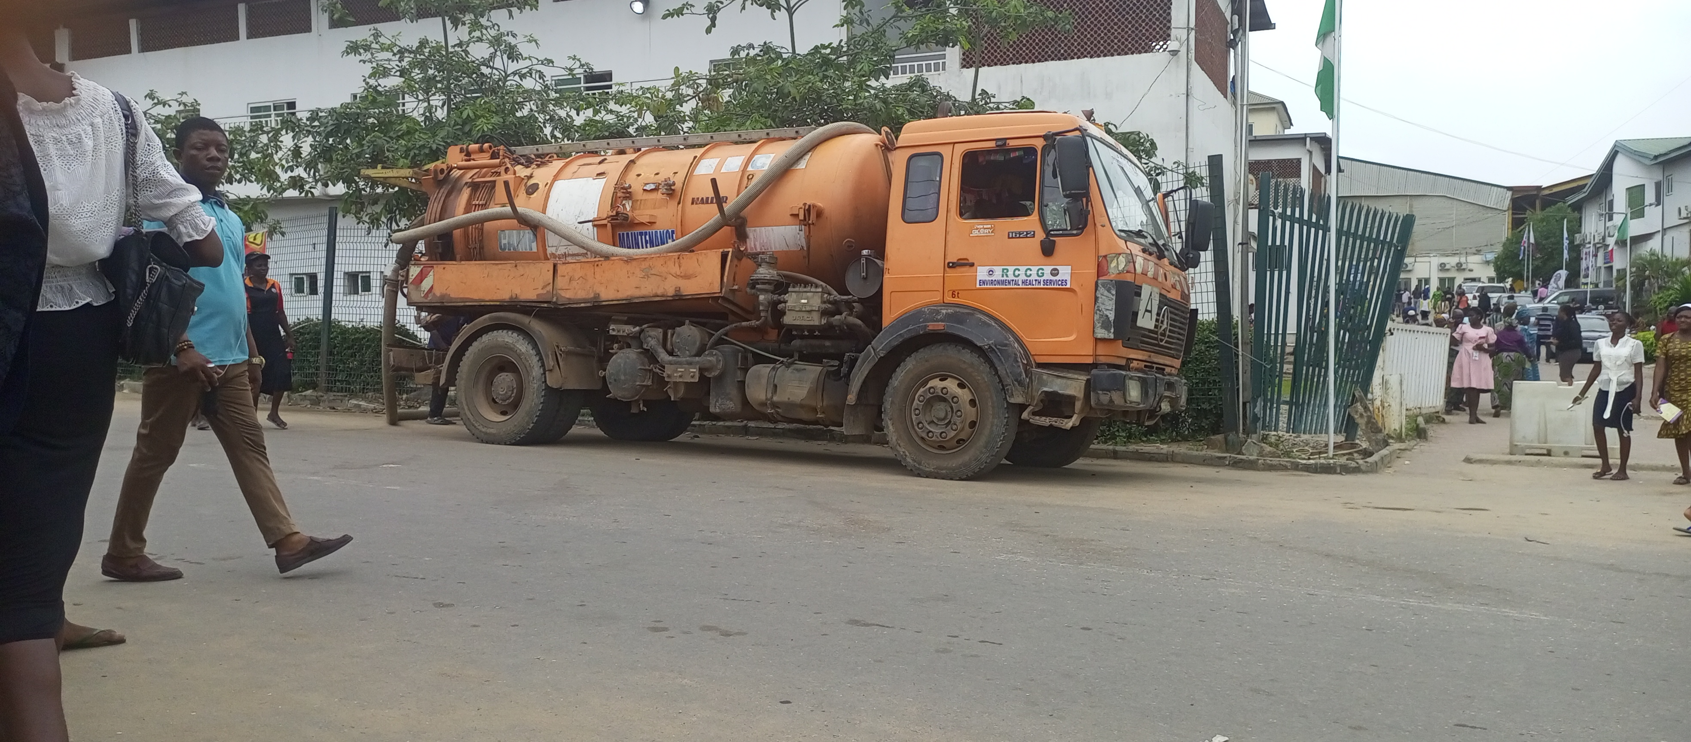
Waste disposal
Waste disposal (Sewage/Refuse) include the activities and action required to manage waste from its inception to its final disposal.
This includes the collection, transpot, treatment and disposal of waste, together with monitoring and regulation of the waste management process.

Slide 8
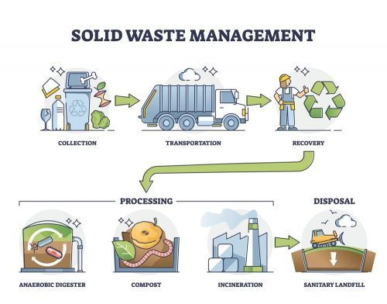
Methods of waste disposal
Dumping.
Controlled tipping or sanitary land fill.
Incineration.
Composting
Manure pits.
Burial method.

Slide 9
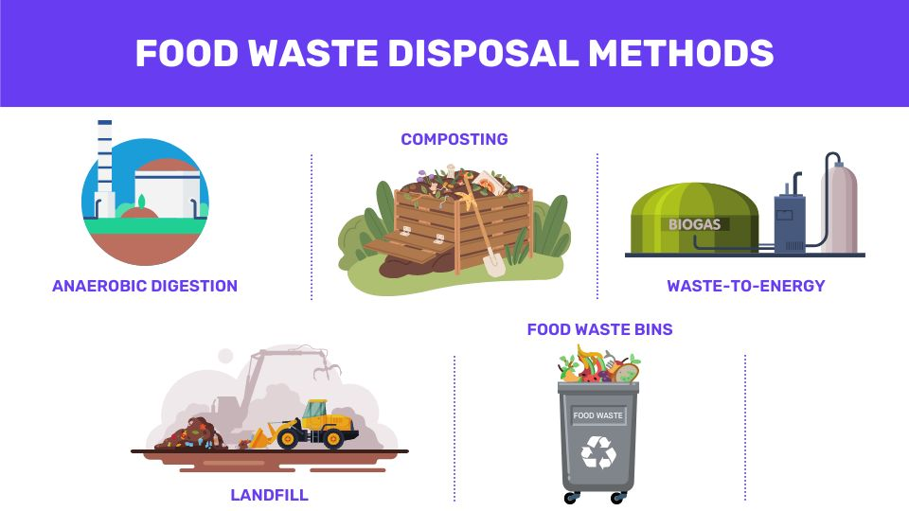

Slide 10
Vector and Vermin control
Control method;
- Physical method (removing unused plastic, old buckets,stagnant water storage).
- Mechanical method (use of trap, stongun).
- Chemical method (Insecticides, Larvicides etc).
- Environmental method (using natural enemies eg: Gambusia, Rat).

Slide 11
Housing Sanitation.
CHARACTERISTIC OF AN ACCEPTABLE HOUSE.
- Adequate space; at least 50 sq.ft. per person.
- Adequate lighting.
- Adequate water supply.
- Noise; should not be more than 30 decibels.
- Adequate heat and ventilation.
- Equipped with sanitary toilet, food storage and proper refuse disposal.

Slide 12
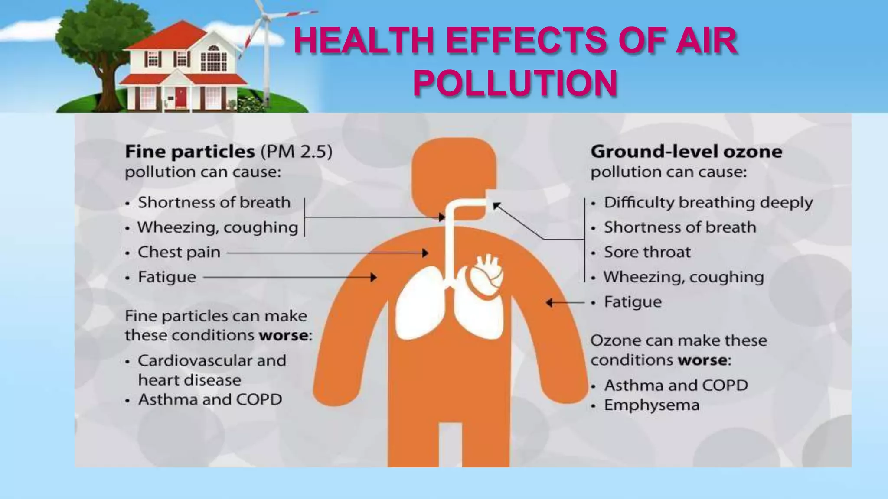
Air Sanitation
Air pollution occurs when harmful or excessive quantities of substances are introduced into the atmosphere.
Air sanitation is the system of removing the impurities present in air inside buildings to protect people from infections.

Slide 13
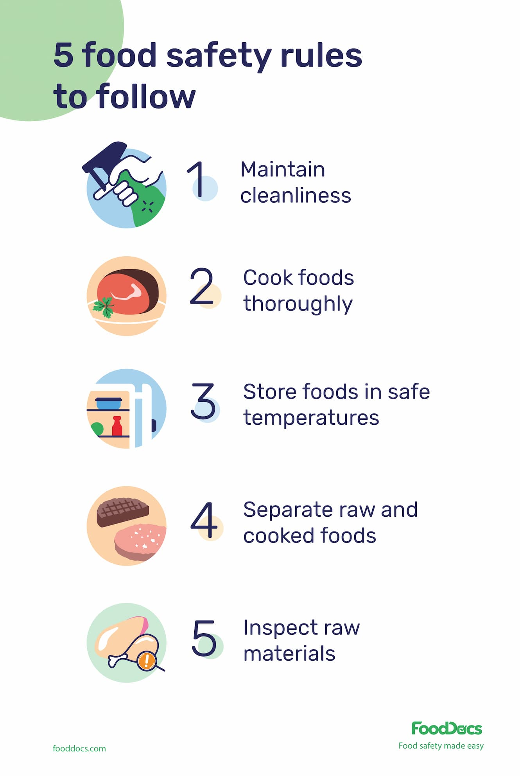
Food Sanitation
It includes all practices involved in protecting food from risk of contamination, harmful bacteria, poisons and foreign bodies, preventing any bacteria from multiplying to an extent which would result in an illness of consumers; and destroying any harmful bacteria in the food by thorough cooking or processing.
Types of food contaminants
Biological contaminants e.g; Sea food toxins, Mushroom toxins, Salmonella bacteria.
Physical contaminants e.g; Hair, Dust and staple wire etc.
Chemical contaminants e.g; Toxic metal, Pesticides, Cleaning product, Sanitizers etc.

Slide 14
PURPOSE OF SANITATION
the overall purpose of sanitation are:
To provide a healthy living environment for everyone.
To protect the natural resources (groung water,surface water, soil).
To provide safety, security and dignity for people when they defecate or urinate.
To safely reduce human exposure to pathogens.
To prevent breeding places of insects and rodents that may be carrier of diseases.
To maintain and practice healthy lifestyles.
It improves the quality of life.

Slide 15
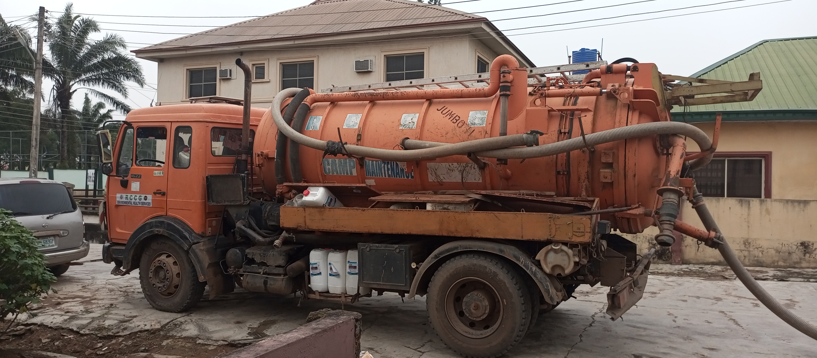
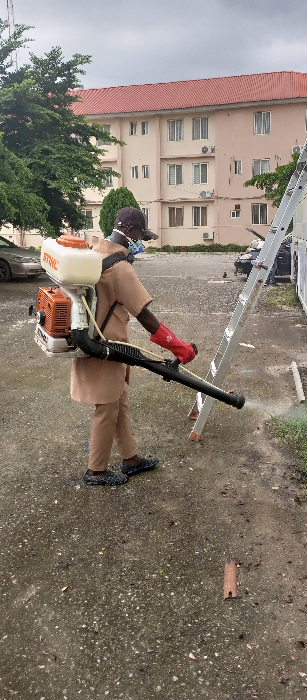
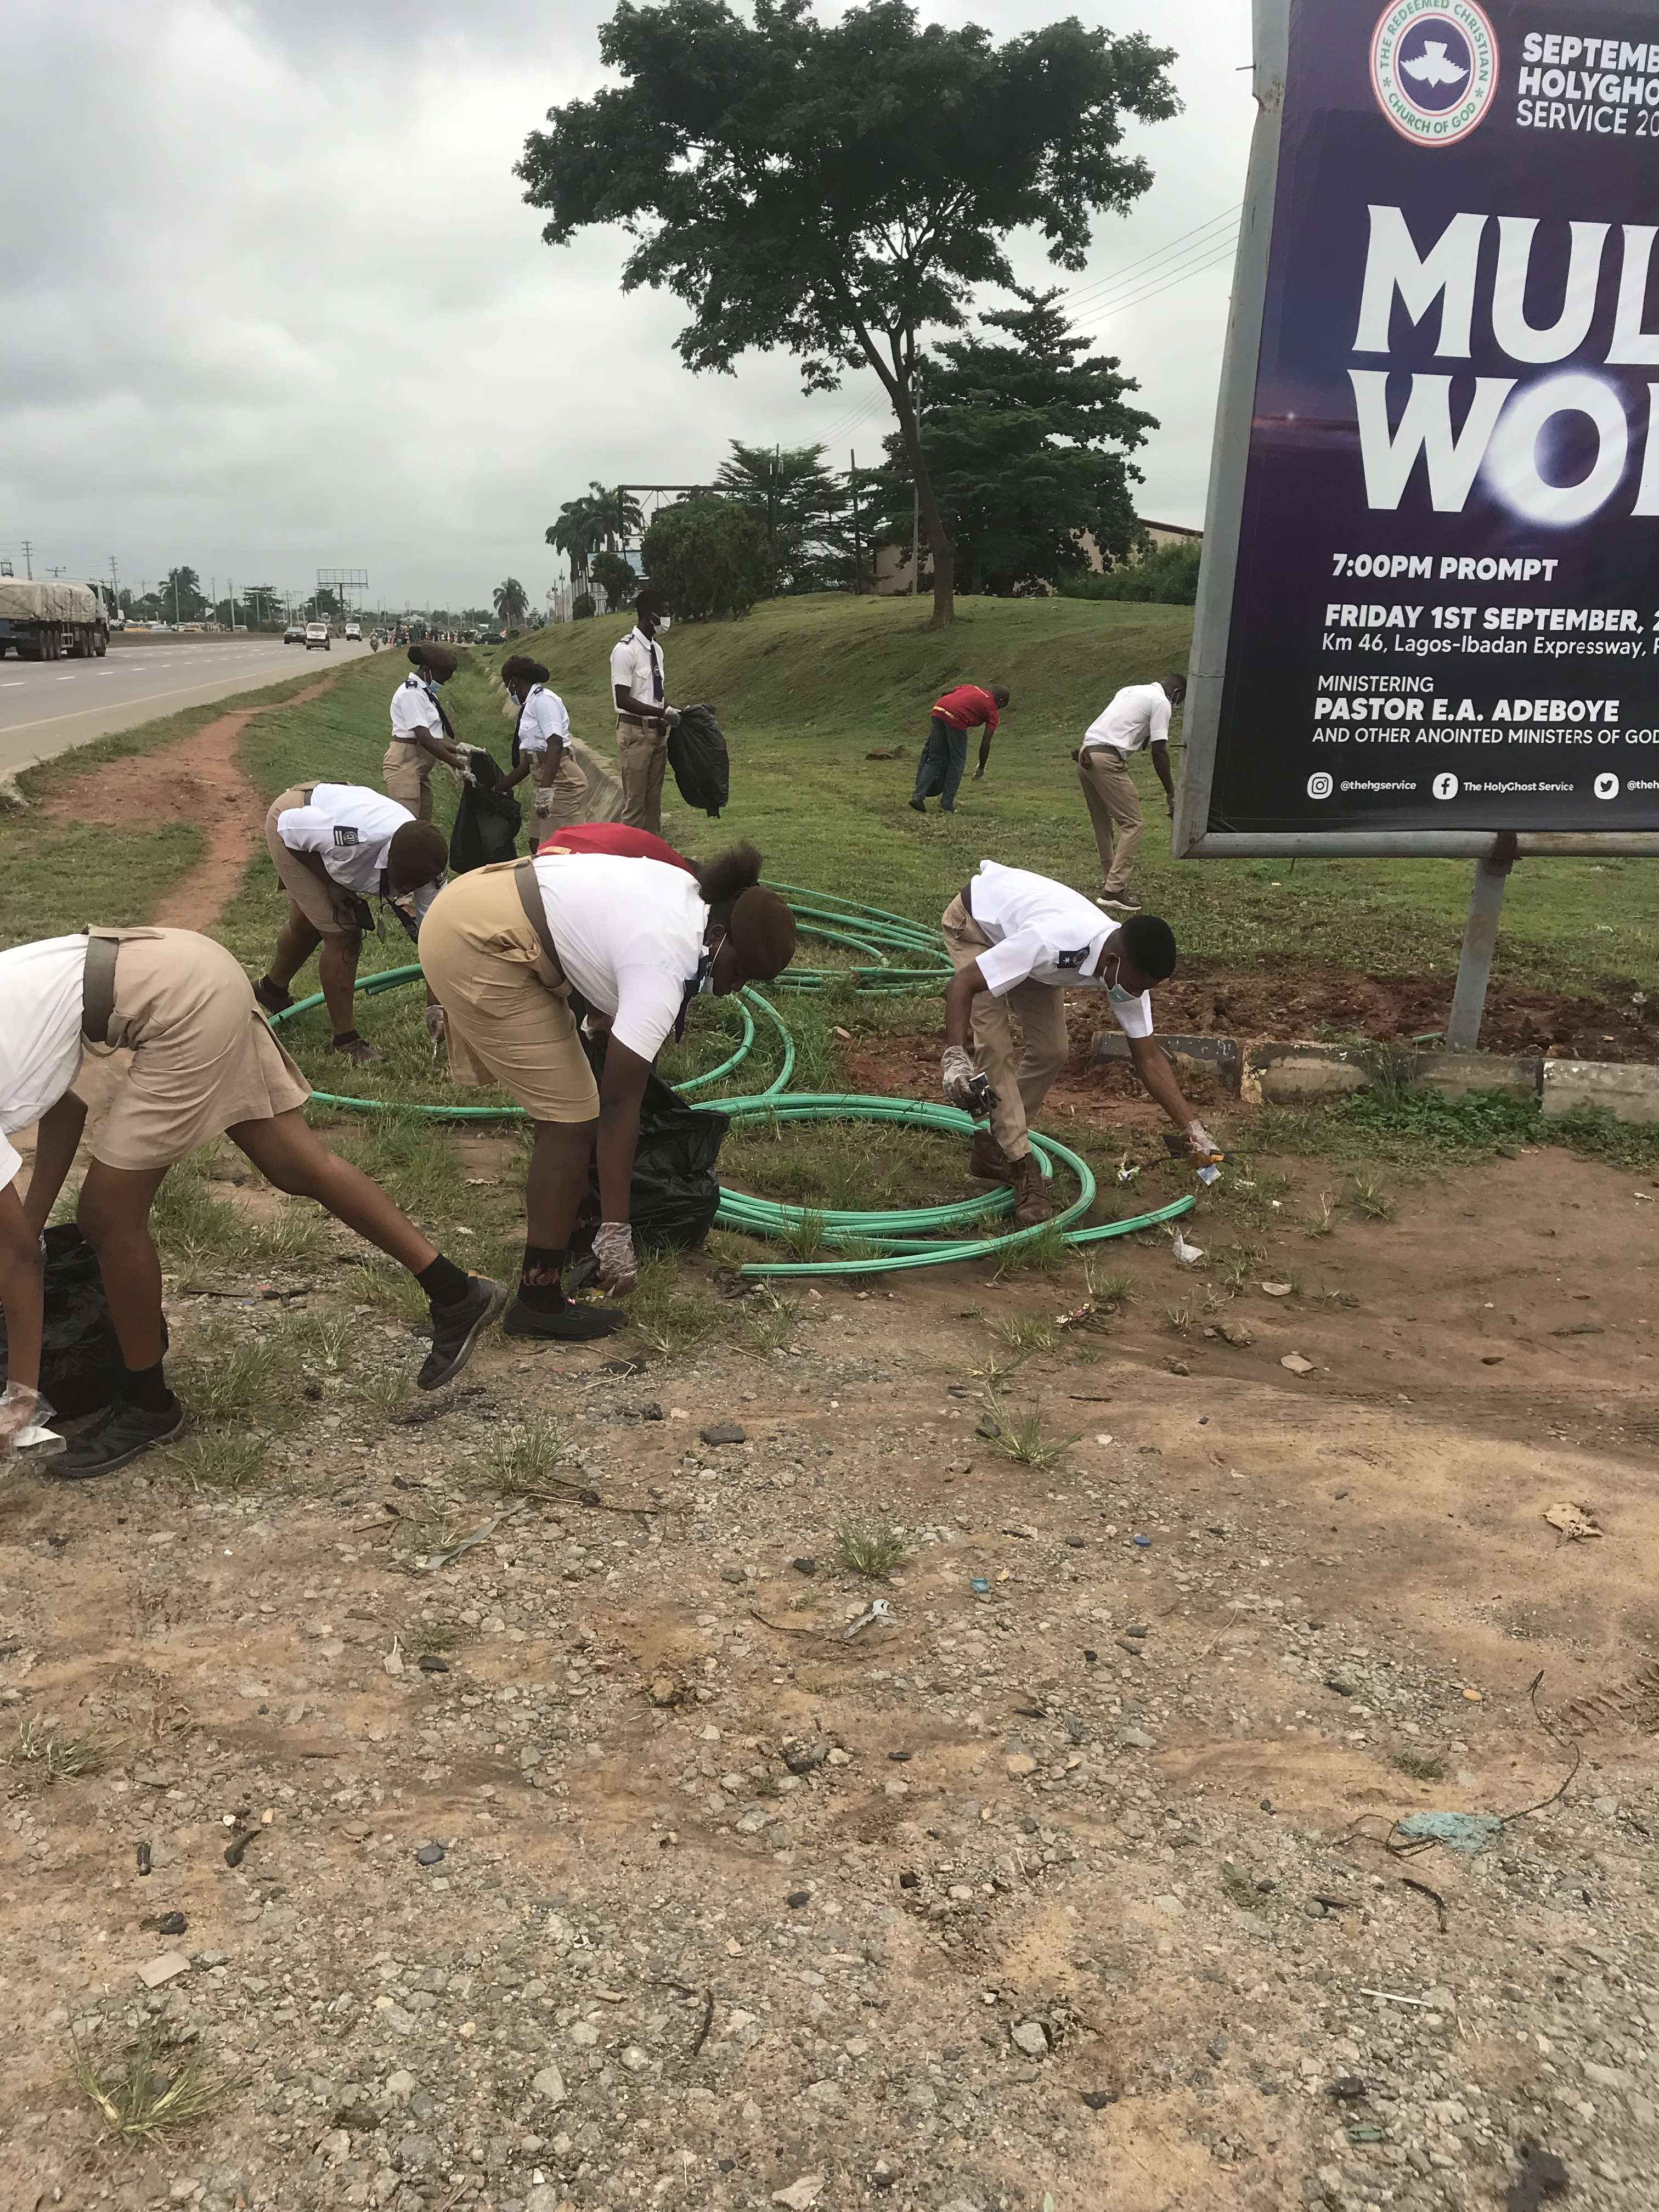
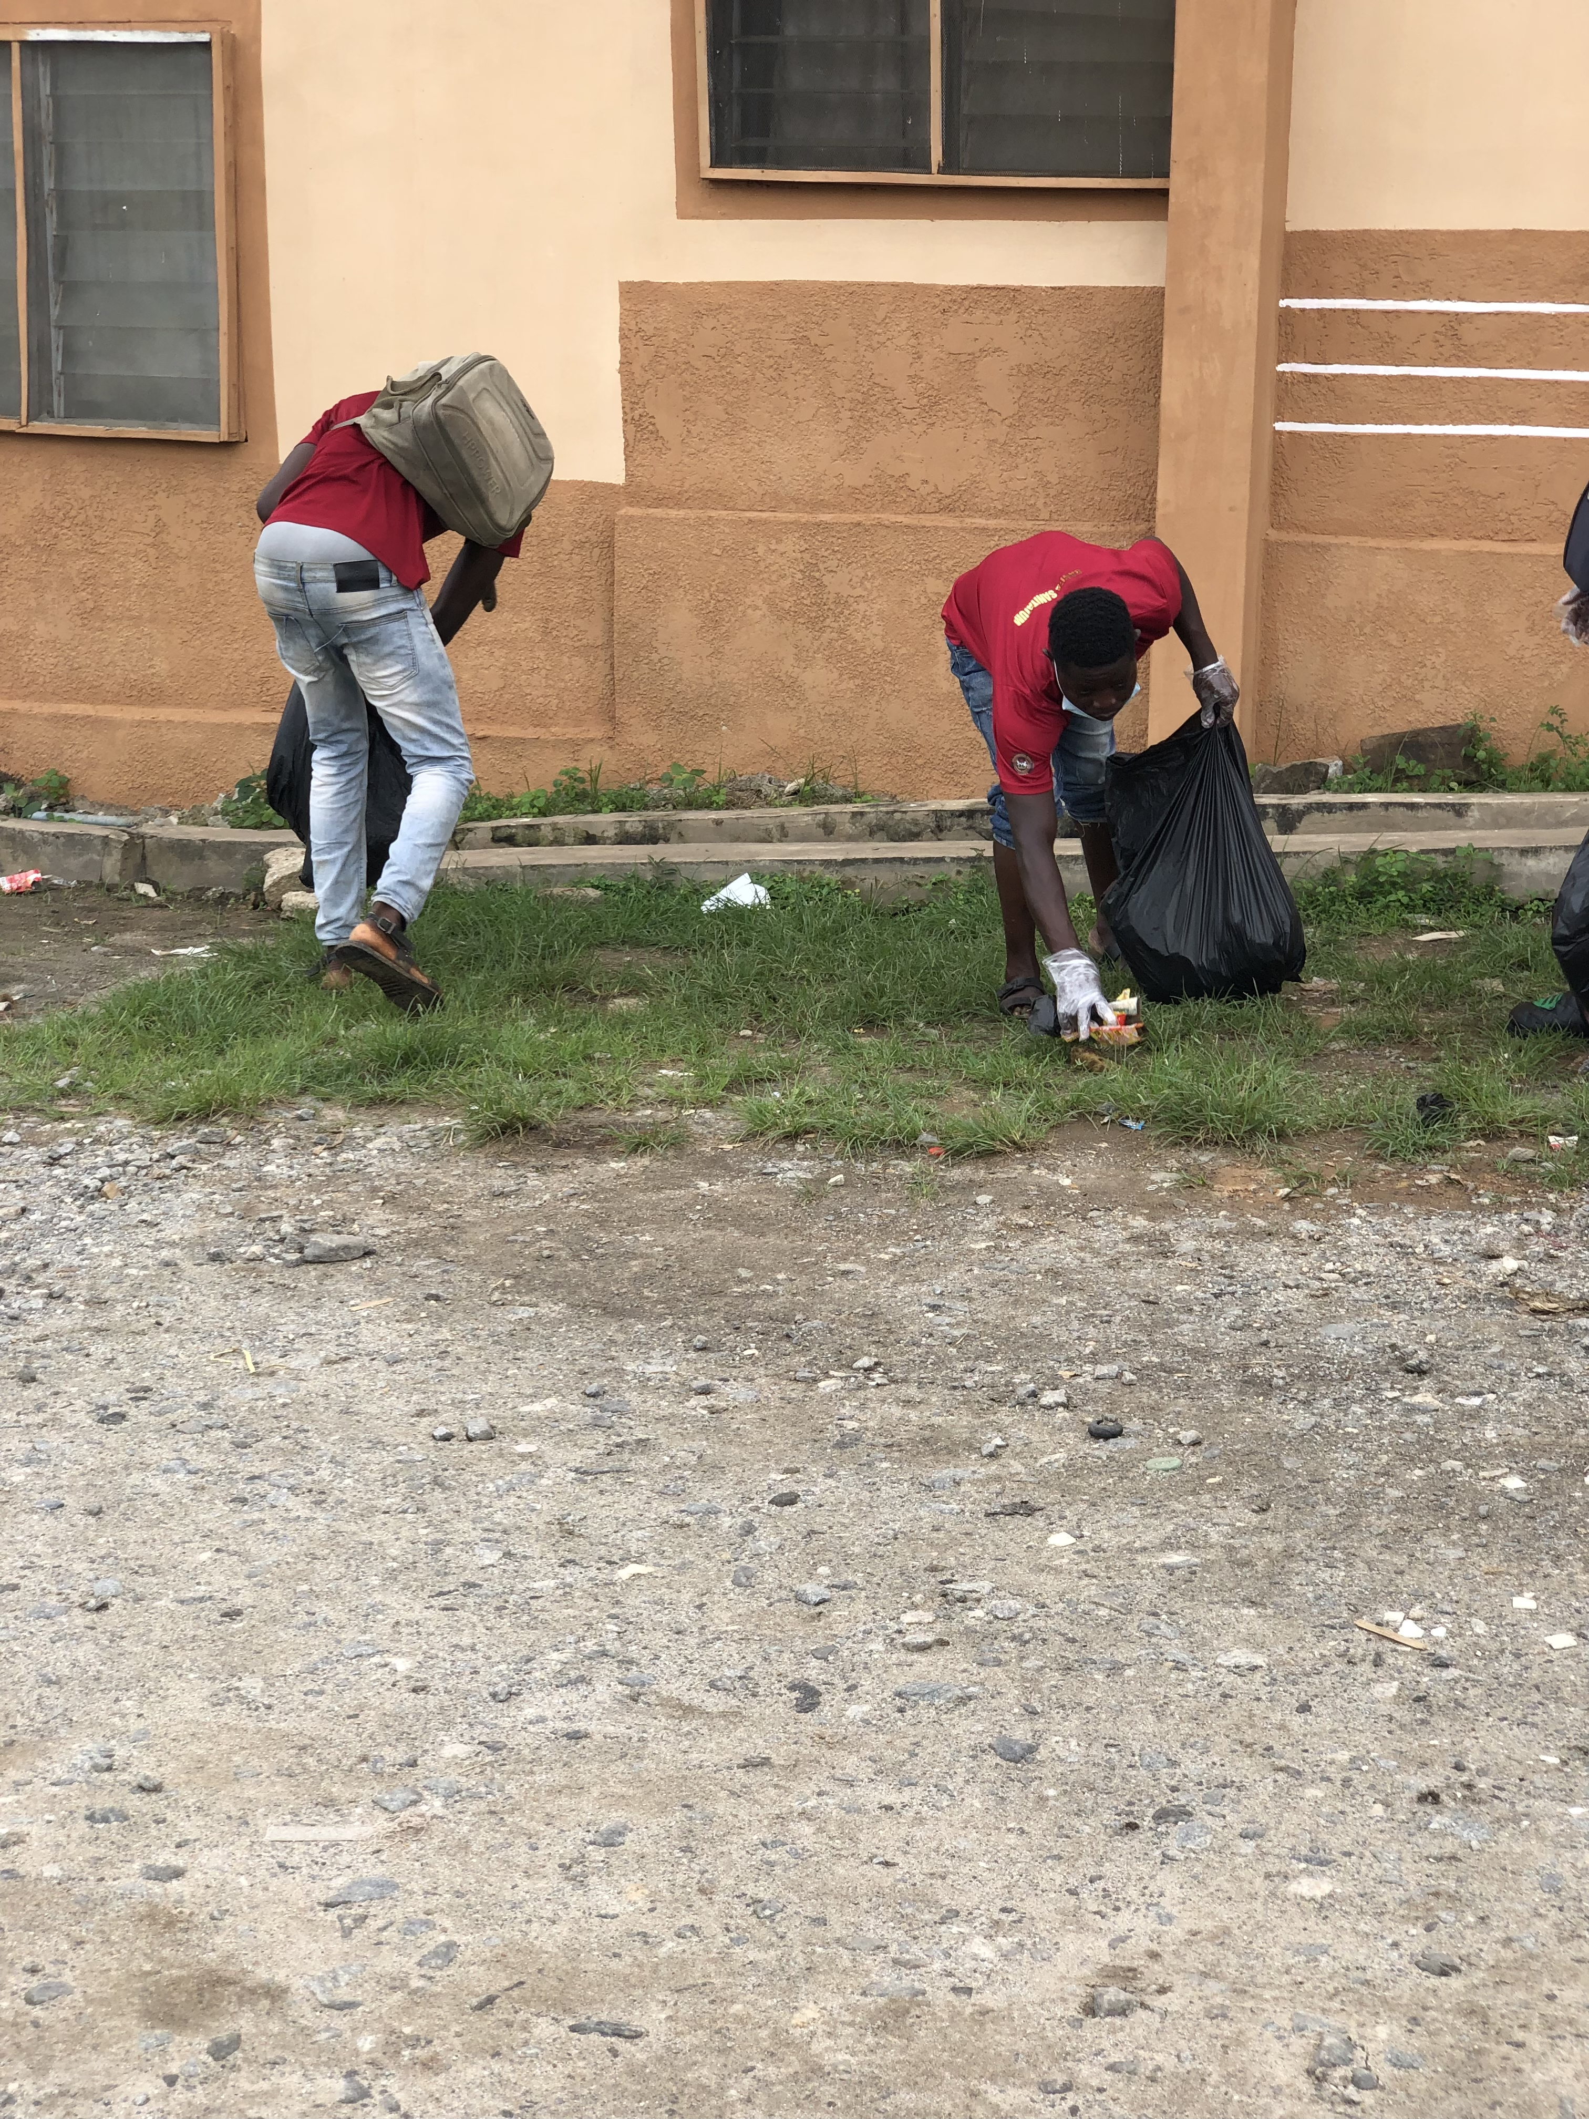
ENVIRONMENTAL ACTIVITIES AT REDEMPTION CITY

Slide 16
Conclusion
Sanitation and waste management are important driving forces for community health in Nigeria.
A clean environment, open defecation free areas, personal hygiene practices among the individuals, proper solid and liquid waste management, and availability of adequate safe drinking water determine the health of individuals as well as the community. Good quality housing is a key element for ensuring a healthy community. Poor housing can lead to many health problems and is associated with infectious diseasea as TB and Cholera etc.
Awareness and health education is the major tool to overcome health and sanitation issues.
Healthy mind lives in healthy body and healthy mind ensures happy living and progress.

Slide 17
REFERENCES
https://www.researchgate.net/publication/359577859_WHO_Guidelines_on_Sanitation_and_Health_English
https://www.slideshare.net/slideshow/sanitation-249754155/249754155?from_search=5#7
https://www.slideshare.net/slideshow/environmental-sanitation-health-education-vital-statistics/242207851#8
https://www.slideshare.net/slideshow/environmentalsanitation/66501465?from_search=4#31
https://www.slideshare.net/slideshow/food-sanitation-47512923/47512923
https://www.slideshare.net/slideshow/environmental-sanitation-health-education-vital-statistics/242207851#55
https://www.slideshare.net/slideshow/environmental-sanitation-for-msc-nursing/127348377#7
https://www.slideshare.net/slideshow/health-sanitation/43119295?from_search=20#40

Slide 18
THANK YOU....

