Slide 1
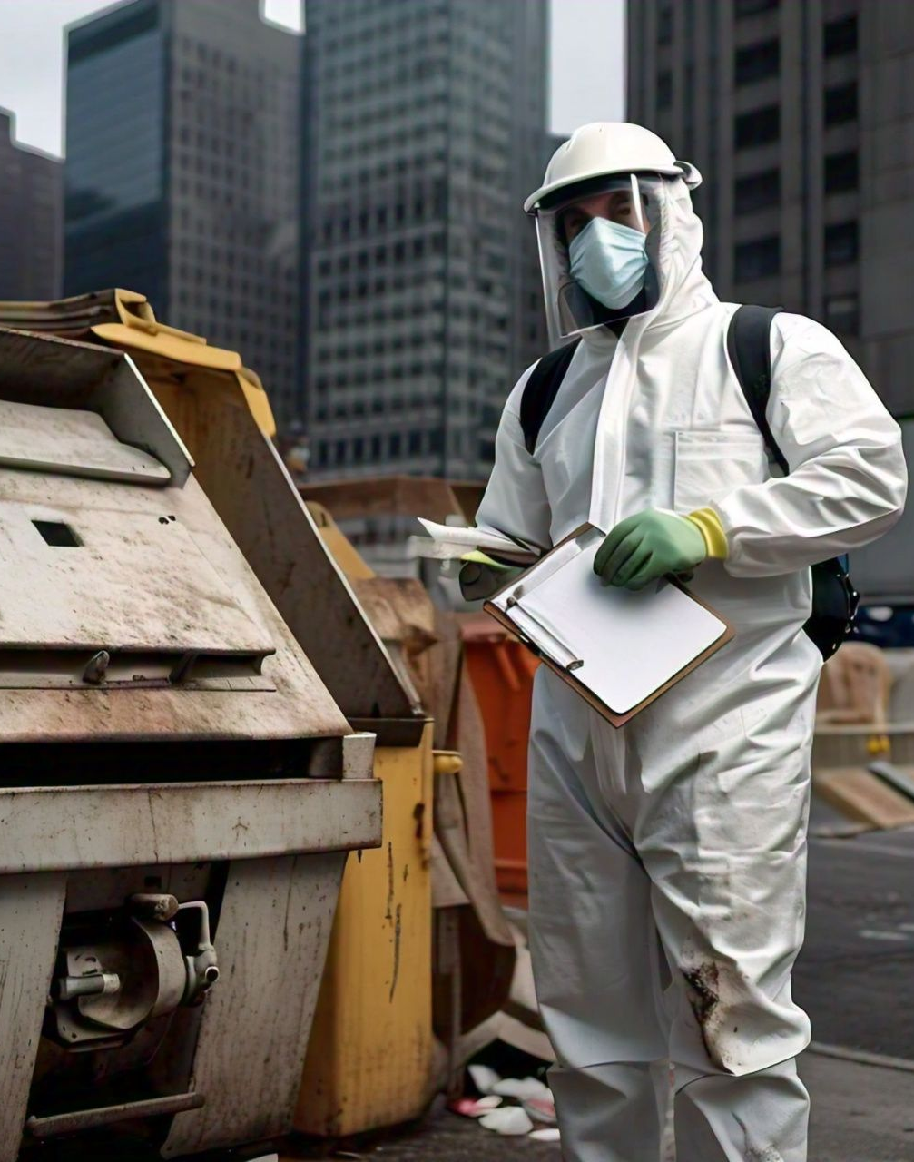
ETHICS OF SANITATION MINISTRY
Presented by:-
DR. TUNDE O. BANKOLE, FCCA
((A researcher, Academician,
Human Resources coach and
Freelance Writer)
REGIONAL CONFERENCE, REGION 1, SANITATION MINISTRY
Venue: LAGOS PROVINCE 45, RCCG GARDEN OF PEACE, SURULERE, LAGOS
Date: SUNDAY 14 JULY 2024

Slide 2
INTRODUCTION
May I take this singular opportunity to appreciate the Authorities and organizers of this conference for the confidence they have in me, to have accorded me with the privilege and responsibility of being one of the speakers for this noble conference. I did not take this for granted. Thank you so much and God bless you.
Every Department in the Church is meant to influence the Vision of the Church and the Church service. Every Functional Department is meant to contribute and impact the Church Service.

Slide 3
To have an effective service in our church / Parish, the following must be worked upon
We need to build a culture, pattern, tradition or system in our church. We need to cultivate a culture on cleanliness, providing a comfortable and pleasant atmosphere for worshippers. We need to sensitize and orient our people about this culture, so that it becomes a tradition that even the new members that are coming in can align with. We must be known for something. Let something register in the mind of the new worshipper about us. (Build a system for your church and each department in the church).
Every Department must contribute and impact the service.
After every service, we must measure performance, as a Church and as a Department. Every service must be a service where lives are transformed, impacted and touched. The service is not all about you but all about God and the people. We must be particular about the take home. We must be very intentional about this. We need to create a mental picture of the Church image on the people. Ask yourself, what will this people go home with? E.g Revelation of the word, Healing, Excitement, Testimonies, etc. We must have what we want to achieve after each service. Worshippers must be able to say something about us after each service.
Effective service is a service where lives are touched, and people are left with memories.
.

Slide 4
Understand this that "MINISTRY is Daily, Church is WEEKLY".
SANITATION MINISTRY is very vital and a core department in the Church that defines, gives proper projection and accurate identity about the Church / Parish, more importantly what people should expect. An excellent and well-organized Church / Parish don't joke with Sanitation department.
A Church that careless about a clean, safe and welcoming environment for worshippers cannot be a loving Church.
Caring for your members welfare and wellbeing starts from creating an atmosphere conducive for worshippers and Holy Spirit to operate. Be intentional about this and don't be too spiritual or religious about it.
Your Church toilet or environment can send members away from your Church. Someone that comes to your Church and contact disease or infection will never come again. Sanitation department is so important that they create a platform that foster easy flow and manifestation of the Power of God during the service..

Slide 5
PRIMARY RESPONSIBILITY OF THE SANITATION MINISTRY / DEPARTMENT
Maintain a Health and Hygiene Standard: Ensures a clean and hygienic environment, preventing the spread of diseases and illnesses within and outside the Church(the Church Gutter), ensuring adequate waste disposal.
Hospitality and Comfort for Worshippers: Create a welcoming, comfortable and pleasant atmosphere that reflect the Church's values.
Foster Engagement: Raise / recruit Volunteers, coordinate cleaning schedules. Engage and intimate people with the vision of sanitation ministry. Educate and orient the Church congregation on the important of sanitation and hygiene.
Safety: Ensuring a safe space for all Church activities. Identifies and addresses potential hazards. Sanitation Team must arrive earlier before any service to check and ensure the environment is safe for worshipper.
Proper Management & Maintenance: Responsible management of resources, demonstrating good stewardship of the church's facilities and assets.

Slide 6
PRIMARY RESPONSIBILITY OF THE SANITATION MINISTRY / DEPARTMENT Contd…
Show God's Character: To demonstrate the love of God and care for His people, it must practically reflect in our character and ways. Reflecting the Church's values by serving with dignity, love and excellent character
Support The Assembly Pastor and other Department: Take Stress off the pastor which allows him to focus. Knowing that the environment is well maintained, enables other ministries to focus on their roles. A clean and comfortable environment enhances the worship experience, allowing focus on spiritual growth. Collaborating with other department to support Church events and activities.
Engage in Community Outreach: Supports outreach programs, serving the community and demonstrating Christ's love through practical service. Shows the community that the church values cleanliness and hygiene, testifying to God's love and care.
The Local Church is more than just a meeting point: It is the very heart and hope of the Community. The church is in a prime position to mobilize communities and work with them to improve access to sanitation and effect behavior change for better hygiene.

Slide 7
THE PROFESSIONAL ETHICS OF SANITATION MINISTRY
ETHICS are Moral principles that govern a person's behaviour or the conducting of an activities. Ethics is a system that say what is and what is not acceptable. Ethics aims at discerning which values ought to be praised and which one ought to be discourage. It helps to define what we ought or ought not to do.
Professional Ethics are principles that govern the behavior of the sanitation officer / team in their service delivery.
Professional ethics for sanitation ministry encompass the personal and corporate standards of behavior expected from a sanitation personnel.
Why is Professional Ethics important?
A professional code of ethics is designed to ensure that sanitation personnel are behaving in a manner that is socially acceptable and respectful of one another.
It establishes the rules for behavior and sends a message to every Team member that universal compliance is expected.
It also provides the groundwork for a preemptive warning if personnel break the code.

Slide 8
The Ethics of Sanitation Ministry demands the following:
Positive Attitude: - People can be very frustrating and provoking but always wear a Good moral conduct, such like Humility, patient, tolerance, good manner of approach, etc. On no account must be insult anyone when you're in the line on duty. The ethics of this ministry demands that you will able to take a lot of insult. Appropriate use of language, good verbal and nonverbal interaction skills, eye contact, a friendly smile and genuine respect for people. Professional Conduct in Service Delivery. Refrain from any harassment before, during and after service delivery.
Professional Appearance: - Always put on your, kits, jacket and hand glove. Practice what you represent, Be Neat and well dressed. Professionals are commonly judge by the way they look. For instance, uniforms / kits for sanitation team are intended to project an image of safety, competency and professionalism.
Competency: - The core of being a professional is showing a basic foundation of competence in your job.
No unfair treatment or discrimination on the basis of gender, race, status or Nationality. Deliver your duty with fairness to all.

Slide 9
The Ethics of Sanitation Ministry demands the following Contd…:
Responsibility and Accountability: - Take ownership of sanitation tasks and report any issues or concerns to relevant authorities. Being responsible is a common concept of professionalism. This means that professionals uphold high standards and accept the duties of their position along with taking responsibility when things don't work out.
Continuous improvement: - Stay updated on best practices and technologies to improve sanitation services.
Integrity: - Refrain from any form of crime or criminal act.

Slide 10


